Slide 1
Skinker DeBaliviere, DeBaliviere Place, West End, Visitation Park
Monthly Crime Report: December 2020
Washington University Medical Center

Slide 2
Skinker DeBaliviere: Summary Notes
7 total crimes in December 2020
-50% change compared to December 2019 (14 total crimes)
4 crime(s) against persons in December 2020
300% change compared to December 2019 (1 crimes against persons)
162 total crimes in 2020
-39% change compared to this time in 2019 (264 total crimes)
13 crime(s) against persons in 2020
-69% change compared to this time in 2019 (42 crimes against persons)

Slide 3
Skinker DeBaliviere: Year to Year Comparison
2019 | 2019 | 2019 | 2019 | 2019 | 2019 | 2019 | 2019 | 2019 | 2019 | 2019 | 2019 | 2019 | 2019
Part 1 Crimes | Jan | Feb | Mar | Apr | May | Jun | Jul | Aug | Sep | Oct | Nov | Dec | Total
Aggravated Assault | 0 | 0 | 7 | 0 | 6 | 1 | 0 | 1 | 0 | 0 | 2 | 1 | 18
Arson | 0 | 0 | 0 | 0 | 0 | 0 | 0 | 0 | 0 | 0 | 0 | 0 | 0
Burgalry | 4 | 9 | 0 | 1 | 4 | 6 | 5 | 2 | 4 | 2 | 1 | 1 | 39
Homicide | 0 | 0 | 0 | 0 | 0 | 0 | 0 | 0 | 0 | 0 | 0 | 1 | 1
Larceny | 4 | 8 | 16 | 18 | 15 | 17 | 21 | 9 | 11 | 20 | 13 | 10 | 162
Motor Vehicle Theft | 1 | 3 | 0 | 0 | 2 | 1 | 1 | 4 | 1 | 2 | 4 | 1 | 20
Rape | 0 | 0 | 0 | 0 | 0 | 0 | 0 | 0 | 0 | 0 | 0 | 0 | 0
Robbery | 1 | 1 | 0 | 2 | 4 | 5 | 1 | 2 | 4 | 1 | 3 | 0 | 24
Total | 10 | 21 | 23 | 21 | 31 | 30 | 28 | 18 | 20 | 25 | 23 | 14 | 264
2020 | 2020 | 2020 | 2020 | 2020 | 2020 | 2020 | 2020 | 2020 | 2020 | 2020 | 2020 | 2020 | 2020
Part 1 Crimes | Jan | Feb | Mar | Apr | May | Jun | Jul | Aug | Sep | Oct | Nov | Dec | Total
Aggravated Assault | 0 | 0 | 0 | 0 | 0 | 2 | 0 | 0 | 0 | 0 | 1 | 1 | 4.0
Arson | 0 | 0 | 0 | 0 | 0 | 0 | 0 | 0 | 0 | 0 | 0 | 0 | 0.0
Burgalry | 3 | 0 | 0 | 1 | 1 | 5 | 0 | 1 | 1 | 5 | 1 | 1 | 19.0
Homicide | 0 | 0 | 0 | 0 | 0 | 0 | 0 | 0 | 0 | 0 | 0 | 0 | 0.0
Larceny | 7 | 7 | 6 | 5 | 4 | 10 | 16 | 10 | 14 | 16 | 9 | 2 | 106.0
Motor Vehicle Theft | 2 | 1 | 2 | 3 | 0 | 1 | 4 | 2 | 4 | 2 | 2 | 0 | 23.0
Rape | 1 | 0 | 0 | 0 | 0 | 0 | 0 | 0 | 0 | 0 | 0 | 0 | 1.0
Robbery | 1 | 1 | 0 | 0 | 0 | 0 | 1 | 1 | 2 | 0 | 0 | 3 | 9.0
Total | 14 | 9 | 8 | 9 | 5 | 18 | 21 | 14 | 21 | 23 | 13 | 7 | 162.0

Slide 4
Skinker DeBaliviere: Summary Tables
Day of the Week | Number of Crimes
Sun | 0
Mon | 1
Tue | 0
Wed | 1
Thu | 2
Fri | 0
Sat | 3
Total | 7
Part 1 Crimes | Number of Crimes
Aggravated Assault | 1
Burgalry | 1
Larceny | 2
Robbery | 3
Total | 7
Crimes Against Persons | Number of Crimes
FALSE | 3
TRUE | 4
Total | 7
Time of Day | Number of Crimes
Day | 7
Total | 7

Slide 5
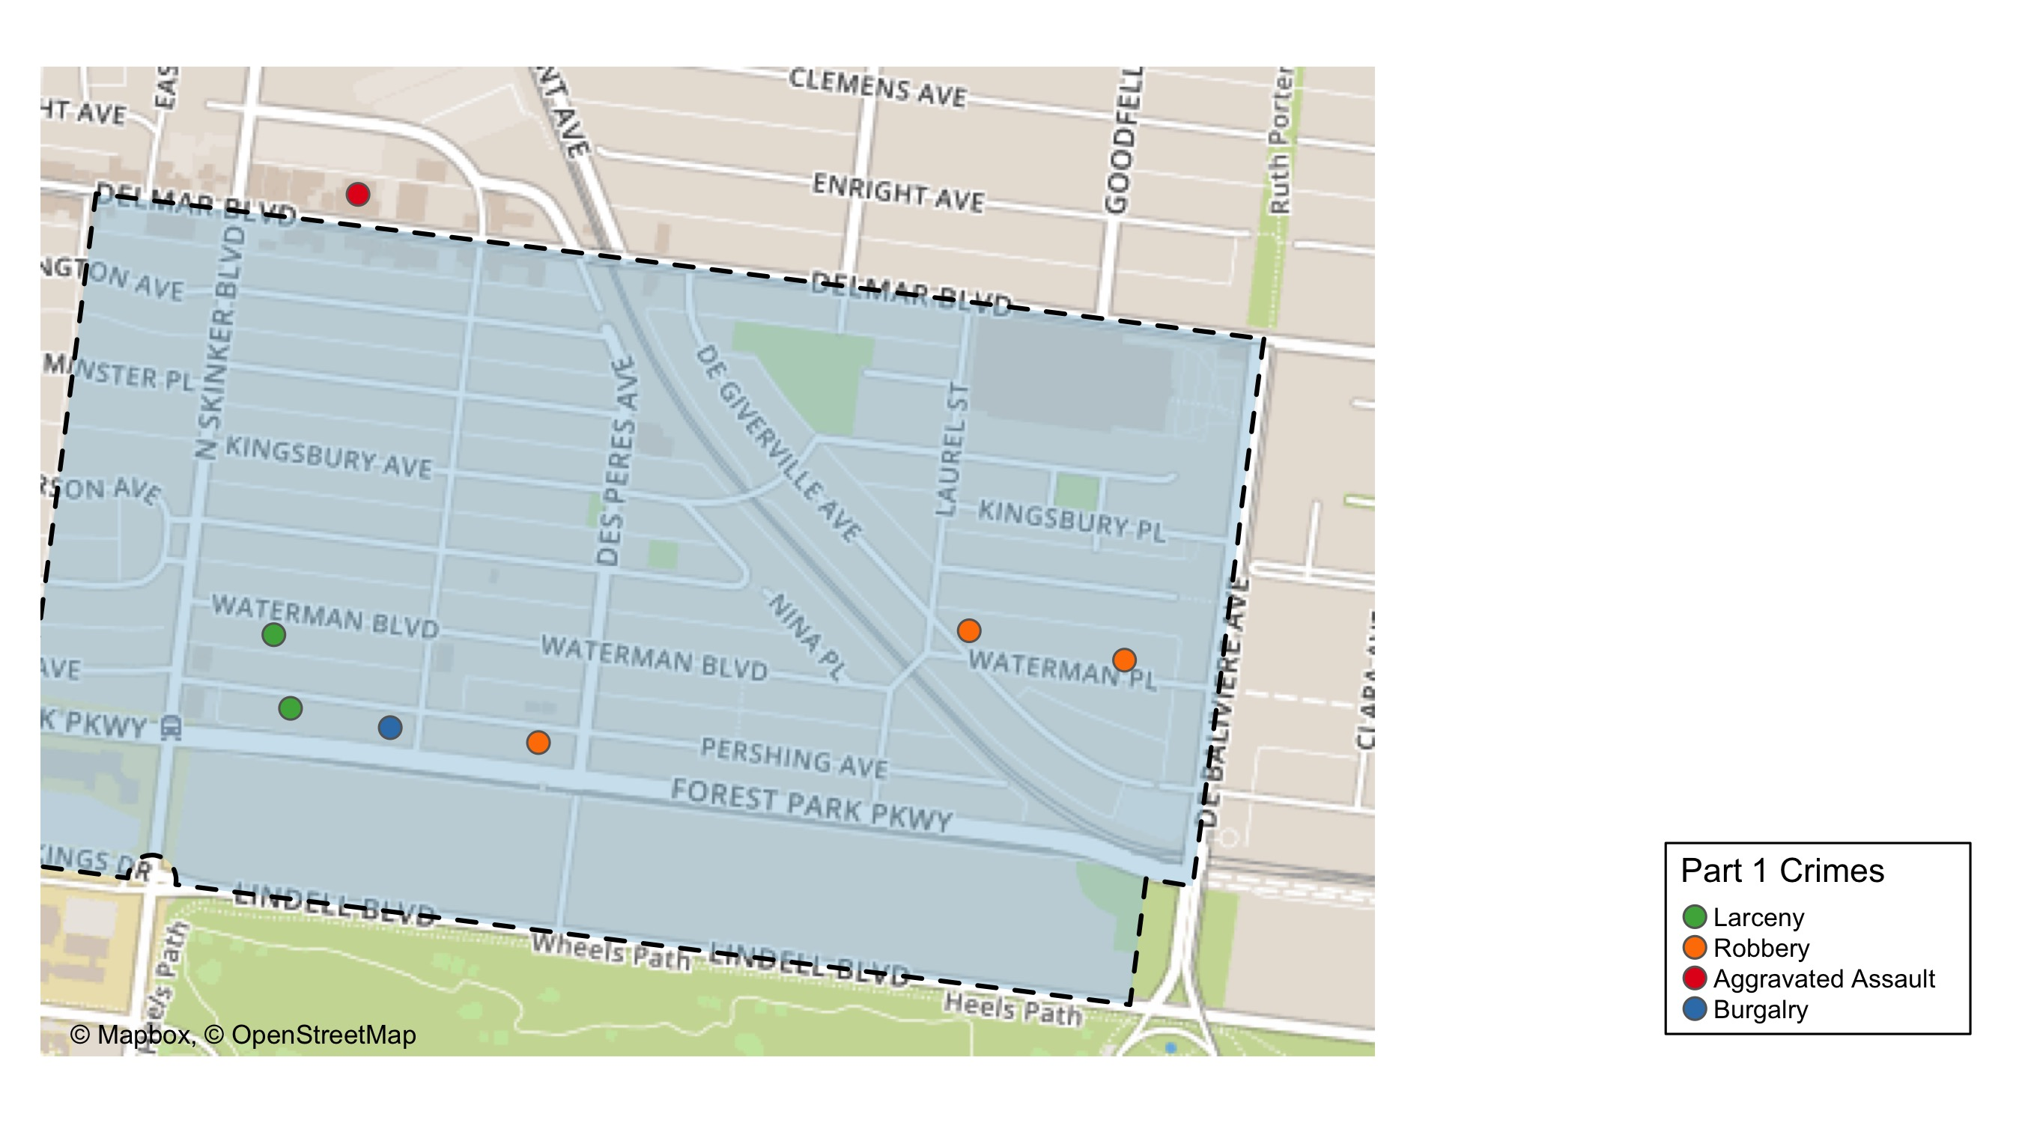
Skinker DeBaliviere: Total Crime Map

Slide 6
DeBaliviere Place: Summary Notes
26 total crimes in December 2020
86% change compared to December 2019 (14 total crimes)
2 crime(s) against persons in December 2020
100% change compared to December 2019 (1 crimes against persons)
202 total crimes in 2020
22% change compared to this time in 2019 (165 total crimes)
37 crime(s) against persons in 2020
61% change compared to this time in 2019 (23 crimes against persons)

Slide 7
DeBaliviere Place: Year to Year Comparison
2019 | 2019 | 2019 | 2019 | 2019 | 2019 | 2019 | 2019 | 2019 | 2019 | 2019 | 2019 | 2019 | 2019
Part 1 Crimes | Jan | Feb | Mar | Apr | May | Jun | Jul | Aug | Sep | Oct | Nov | Dec | Total
Aggravated Assault | 0 | 0 | 0 | 0 | 0 | 2 | 3 | 0 | 5 | 1 | 1 | 1 | 13
Arson | 0 | 0 | 0 | 0 | 0 | 0 | 0 | 0 | 0 | 0 | 0 | 0 | 0
Burgalry | 1 | 0 | 1 | 1 | 2 | 0 | 0 | 2 | 2 | 3 | 0 | 0 | 12
Homicide | 0 | 0 | 0 | 0 | 0 | 0 | 0 | 0 | 0 | 0 | 0 | 0 | 0
Larceny | 8 | 8 | 0 | 4 | 2 | 6 | 10 | 8 | 21 | 8 | 18 | 13 | 106
Motor Vehicle Theft | 0 | 1 | 1 | 2 | 0 | 2 | 3 | 1 | 4 | 7 | 3 | 0 | 24
Rape | 0 | 0 | 0 | 0 | 0 | 0 | 0 | 0 | 0 | 0 | 0 | 0 | 0
Robbery | 2 | 2 | 0 | 1 | 0 | 0 | 3 | 0 | 1 | 0 | 1 | 0 | 10
Total | 11 | 11 | 2 | 8 | 4 | 10 | 19 | 11 | 33 | 19 | 23 | 14 | 165
2020 | 2020 | 2020 | 2020 | 2020 | 2020 | 2020 | 2020 | 2020 | 2020 | 2020 | 2020 | 2020 | 2020
Part 1 Crimes | Jan | Feb | Mar | Apr | May | Jun | Jul | Aug | Sep | Oct | Nov | Dec | Total
Aggravated Assault | 4 | 4 | 1 | 0 | 0 | 2 | 4 | 0 | 4 | 1 | 0 | 0 | 20.0
Arson | 0 | 0 | 0 | 0 | 0 | 0 | 0 | 1 | 0 | 0 | 0 | 0 | 1.0
Burgalry | 0 | 0 | 0 | 0 | 0 | 0 | 0 | 2 | 2 | 2 | 0 | 1 | 7.0
Homicide | 0 | 0 | 0 | 0 | 0 | 0 | 1 | 0 | 0 | 0 | 0 | 0 | 1.0
Larceny | 5 | 7 | 14 | 7 | 13 | 6 | 17 | 9 | 9 | 14 | 17 | 20 | 138.0
Motor Vehicle Theft | 0 | 1 | 0 | 3 | 0 | 4 | 1 | 0 | 0 | 4 | 2 | 3 | 18.0
Rape | 0 | 0 | 0 | 0 | 0 | 0 | 0 | 0 | 0 | 0 | 0 | 0 | 0.0
Robbery | 3 | 2 | 0 | 0 | 1 | 2 | 4 | 0 | 0 | 1 | 2 | 2 | 17.0
Total | 12 | 14 | 15 | 10 | 14 | 14 | 27 | 12 | 15 | 22 | 21 | 26 | 202.0

Slide 8
DeBaliviere Place: Summary Tables
Day of the Week | Number of Crimes
Sun | 3
Mon | 3
Tue | 2
Wed | 2
Thu | 6
Fri | 7
Sat | 3
Total | 26
Part 1 Crimes | Number of Crimes
Burgalry | 1
Larceny | 20
Motor Vehicle Theft | 3
Robbery | 2
Total | 26
Crimes Against Persons | Number of Crimes
FALSE | 24
TRUE | 2
Total | 26
Time of Day | Number of Crimes
Day | 22
Night | 4
Total | 26

Slide 9
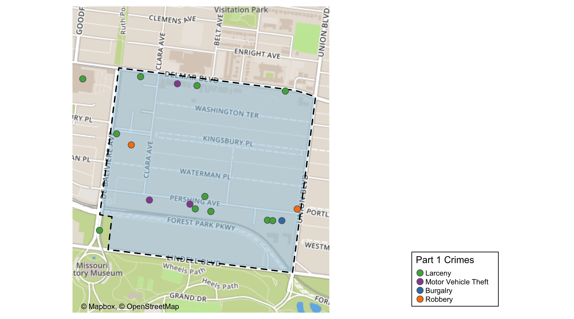
DeBaliviere Place: Total Crime Map

Slide 10
West End: Summary Notes
32 total crimes in December 2020
0% change compared to December 2019 (32 total crimes)
9 crime(s) against persons in December 2020
-31% change compared to December 2019 (13 crimes against persons)
396 total crimes in 2020
-10% change compared to this time in 2019 (441 total crimes)
123 crime(s) against persons in 2020
-18% change compared to this time in 2019 (150 crimes against persons)

Slide 11
West End: Year to Year Comparison
2019 | 2019 | 2019 | 2019 | 2019 | 2019 | 2019 | 2019 | 2019 | 2019 | 2019 | 2019 | 2019 | 2019
Part 1 Crimes | Jan | Feb | Mar | Apr | May | Jun | Jul | Aug | Sep | Oct | Nov | Dec | Total
Aggravated Assault | 6 | 4 | 6 | 13 | 11 | 6 | 9 | 12 | 13 | 11 | 3 | 6 | 100
Arson | 0 | 0 | 0 | 0 | 0 | 0 | 1 | 0 | 1 | 1 | 0 | 0 | 3
Burgalry | 4 | 4 | 5 | 7 | 5 | 4 | 1 | 6 | 6 | 0 | 0 | 4 | 46
Homicide | 0 | 0 | 0 | 0 | 0 | 0 | 1 | 0 | 1 | 0 | 0 | 1 | 3
Larceny | 7 | 13 | 11 | 19 | 12 | 19 | 20 | 22 | 21 | 15 | 17 | 7 | 183
Motor Vehicle Theft | 5 | 5 | 5 | 3 | 2 | 1 | 6 | 5 | 8 | 6 | 3 | 7 | 56
Rape | 0 | 0 | 0 | 0 | 0 | 0 | 0 | 0 | 0 | 0 | 0 | 0 | 0
Robbery | 6 | 4 | 5 | 1 | 2 | 5 | 3 | 4 | 3 | 6 | 4 | 7 | 50
Total | 28 | 30 | 32 | 43 | 32 | 35 | 41 | 49 | 53 | 39 | 27 | 32 | 441
2020 | 2020 | 2020 | 2020 | 2020 | 2020 | 2020 | 2020 | 2020 | 2020 | 2020 | 2020 | 2020 | 2020
Part 1 Crimes | Jan | Feb | Mar | Apr | May | Jun | Jul | Aug | Sep | Oct | Nov | Dec | Total
Aggravated Assault | 10 | 1 | 11 | 14 | 10 | 10 | 13 | 5 | 5 | 8 | 5 | 5 | 97.0
Arson | 0 | 0 | 0 | 1 | 0 | 0 | 1 | 0 | 0 | 0 | 0 | 1 | 3.0
Burgalry | 4 | 3 | 6 | 4 | 2 | 11 | 4 | 4 | 5 | 2 | 5 | 2 | 52.0
Homicide | 1 | 1 | 0 | 1 | 0 | 0 | 2 | 0 | 0 | 0 | 2 | 1 | 8.0
Larceny | 15 | 13 | 8 | 11 | 13 | 13 | 14 | 13 | 12 | 15 | 12 | 16 | 155.0
Motor Vehicle Theft | 3 | 3 | 3 | 5 | 3 | 7 | 6 | 5 | 6 | 2 | 4 | 3 | 50.0
Rape | 0 | 2 | 0 | 0 | 0 | 1 | 0 | 1 | 1 | 0 | 0 | 0 | 5.0
Robbery | 2 | 2 | 0 | 1 | 1 | 0 | 2 | 6 | 3 | 3 | 2 | 4 | 26.0
Total | 35 | 25 | 28 | 37 | 29 | 42 | 42 | 34 | 32 | 30 | 30 | 32 | 396.0

Slide 12
West End: Summary Tables
Day of the Week | Number of Crimes
Sun | 10
Mon | 1
Tue | 4
Wed | 2
Thu | 5
Fri | 3
Sat | 7
Total | 32
Part 1 Crimes | Number of Crimes
Aggravated Assault | 5
Arson | 1
Burgalry | 2
Homicide | 1
Larceny | 16
Motor Vehicle Theft | 3
Robbery | 4
Total | 32
Crimes Against Persons | Number of Crimes
FALSE | 22
TRUE | 10
Total | 32
Time of Day | Number of Crimes
Day | 24
Night | 8
Total | 32

Slide 13
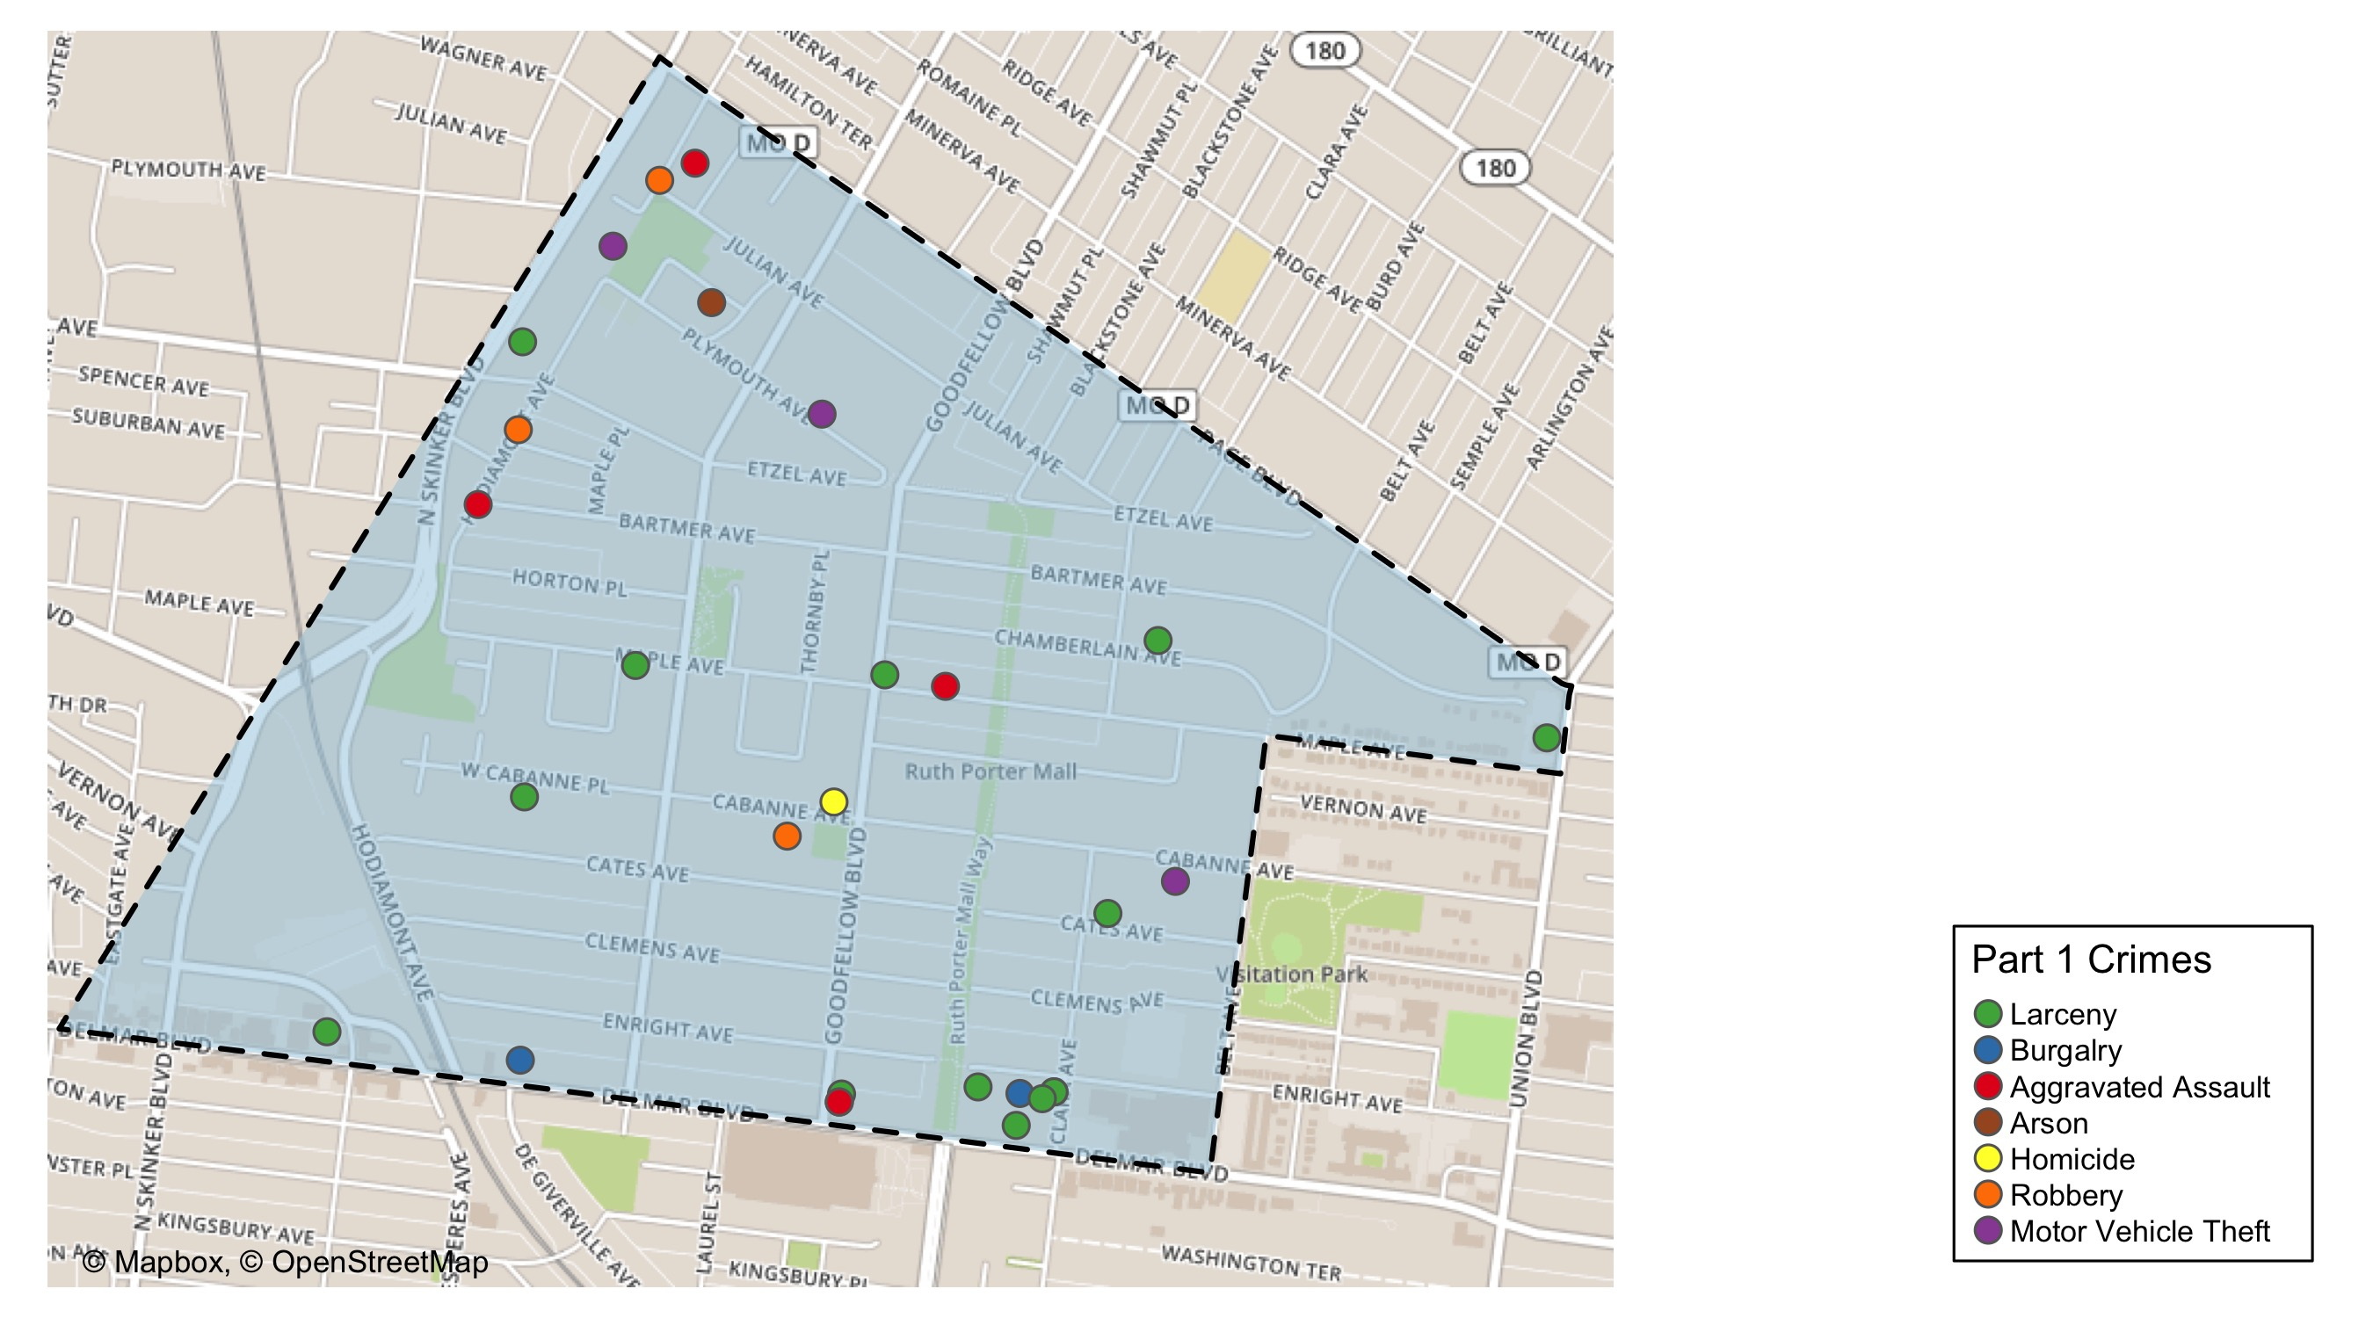
West End: Total Crime Map

Slide 14
Visitation Park: Summary Notes
2 total crimes in December 2020
-60% change compared to December 2019 (5 total crimes)
2 crime(s) against persons in December 2020
0% change compared to December 2019 (2 crimes against persons)
76 total crimes in 2020
27% change compared to this time in 2019 (60 total crimes)
18 crime(s) against persons in 2020
12% change compared to this time in 2019 (16 crimes against persons)

Slide 15
Visitation Park: Year to Year Comparison
2019 | 2019 | 2019 | 2019 | 2019 | 2019 | 2019 | 2019 | 2019 | 2019 | 2019 | 2019 | 2019 | 2019
Part 1 Crimes | Jan | Feb | Mar | Apr | May | Jun | Jul | Aug | Sep | Oct | Nov | Dec | Total
Aggravated Assault | 1 | 0 | 3 | 0 | 0 | 0 | 1 | 1 | 4 | 1 | 0 | 1 | 12
Arson | 0 | 0 | 0 | 0 | 0 | 0 | 0 | 0 | 0 | 0 | 0 | 0 | 0
Burgalry | 0 | 1 | 2 | 1 | 2 | 0 | 0 | 0 | 0 | 0 | 1 | 0 | 7
Homicide | 0 | 0 | 0 | 0 | 1 | 0 | 0 | 0 | 0 | 0 | 0 | 0 | 1
Larceny | 2 | 1 | 1 | 0 | 0 | 1 | 2 | 8 | 2 | 7 | 2 | 3 | 29
Motor Vehicle Theft | 1 | 1 | 0 | 1 | 1 | 0 | 0 | 0 | 1 | 0 | 2 | 0 | 7
Rape | 0 | 0 | 0 | 0 | 0 | 0 | 0 | 0 | 0 | 0 | 0 | 0 | 0
Robbery | 2 | 0 | 0 | 0 | 0 | 0 | 0 | 0 | 0 | 1 | 0 | 1 | 4
Total | 6 | 3 | 6 | 2 | 4 | 1 | 3 | 9 | 7 | 9 | 5 | 5 | 60
2020 | 2020 | 2020 | 2020 | 2020 | 2020 | 2020 | 2020 | 2020 | 2020 | 2020 | 2020 | 2020 | 2020
Part 1 Crimes | Jan | Feb | Mar | Apr | May | Jun | Jul | Aug | Sep | Oct | Nov | Dec | Total
Aggravated Assault | 1 | 1 | 3 | 1 | 4 | 0 | 0 | 1 | 2 | 1 | 0 | 2 | 16.0
Arson | 0 | 0 | 0 | 0 | 0 | 0 | 0 | 0 | 0 | 0 | 0 | 0 | 0.0
Burgalry | 0 | 1 | 1 | 2 | 0 | 1 | 1 | 0 | 0 | 1 | 0 | 0 | 7.0
Homicide | 0 | 0 | 0 | 1 | 1 | 0 | 1 | 0 | 0 | 0 | 0 | 0 | 3.0
Larceny | 0 | 3 | 1 | 5 | 3 | 3 | 7 | 3 | 0 | 4 | 8 | 0 | 37.0
Motor Vehicle Theft | 0 | 0 | 1 | 0 | 0 | 2 | 2 | 1 | 1 | 0 | 0 | 0 | 7.0
Rape | 0 | 2 | 1 | 1 | 0 | 0 | 0 | 0 | 0 | 0 | 0 | 0 | 4.0
Robbery | 0 | 0 | 0 | 1 | 0 | 0 | 0 | 0 | 0 | 1 | 0 | 0 | 2.0
Total | 1 | 7 | 7 | 11 | 8 | 6 | 11 | 5 | 3 | 7 | 8 | 2 | 76.0

Slide 16
Visitation Park: Summary Tables
Day of the Week | Number of Crimes
Sun | 0
Mon | 0
Tue | 0
Wed | 0
Thu | 0
Fri | 0
Sat | 2
Total | 2
Part 1 Crimes | Number of Crimes
Aggravated Assault | 2
Total | 2
Crimes Against Persons | Number of Crimes
TRUE | 2
Total | 2
Time of Day | Number of Crimes
Day | 2
Total | 2

Slide 17
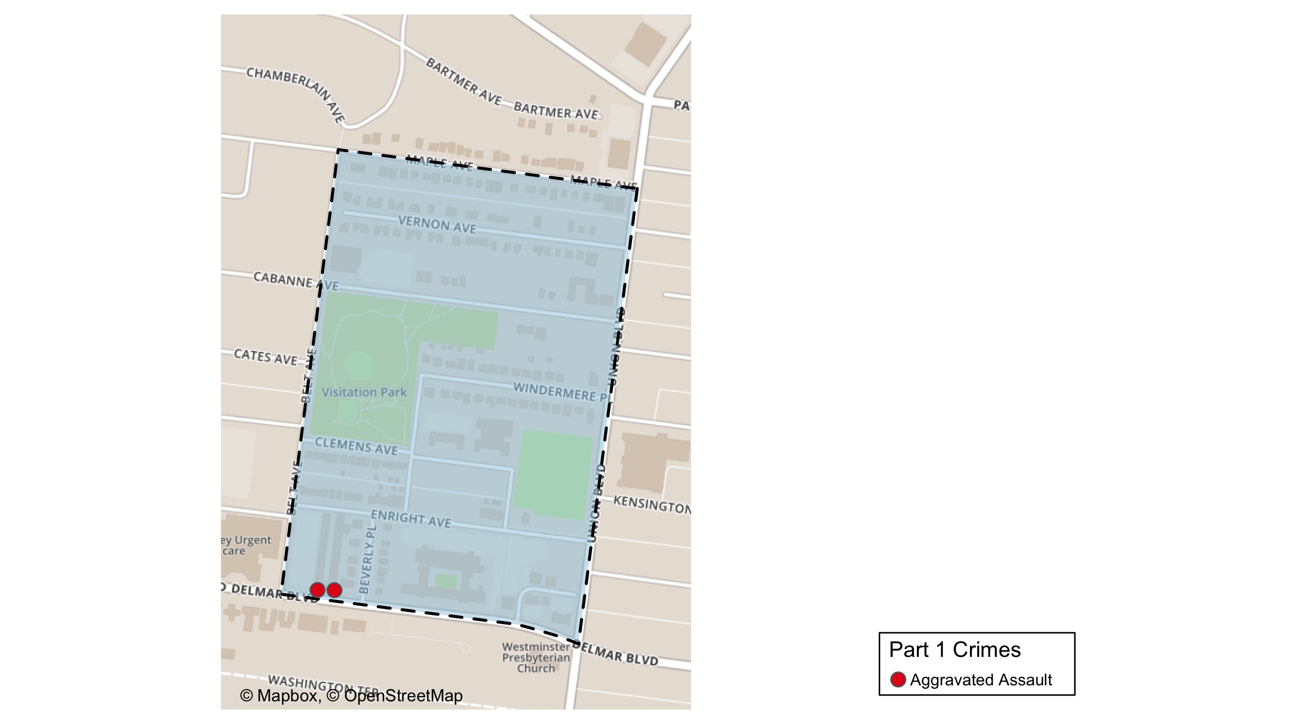
Visitation Park: Total Crime Map

Slide 18
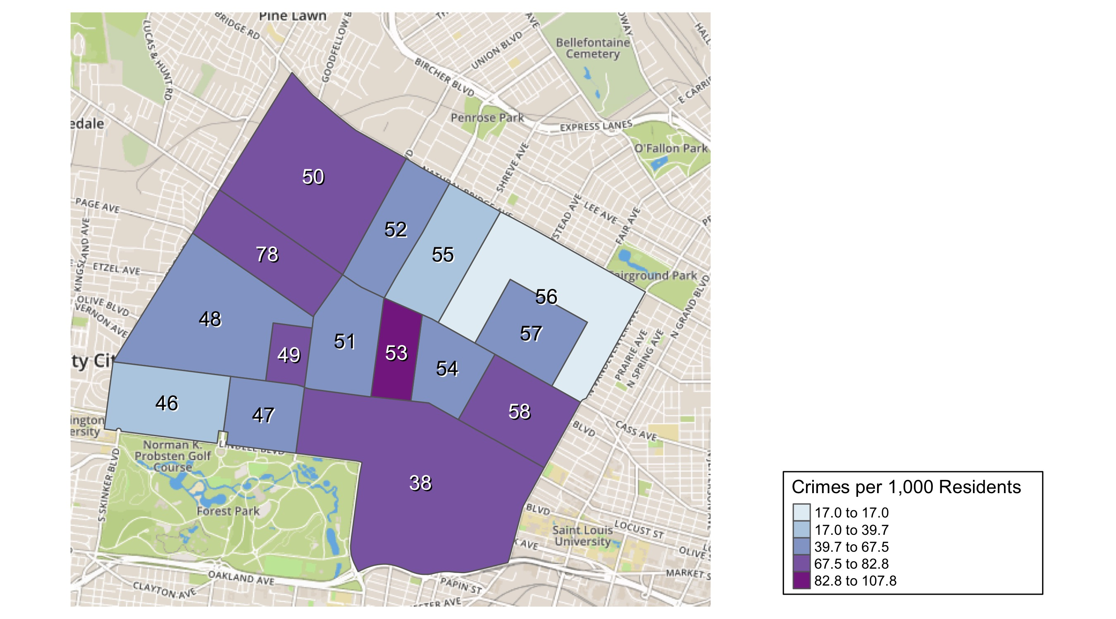
District 5: Crime Rates Map

Slide 19
District 5: Density Map Explanation
There are 15 neighborhoods in District 5
The minimum number of crimes in one neighborhood was 76 (Visitation Park)
The maximum number of crimes in one neighborhood was 1186 (Central West End)
The mean number of crimes in one neighborhood was 257.27
The minimum rate of crimes in one neighborhood was 16.97 (Greater Ville)
The maximum rate of crimes in one neighborhood was 107.82 (Fountain Park)
The mean rate of crimes in one neighborhood was 64.22

Slide 20
Skinker DeBaliviere: Neighborhood Detail
Appendix 1

Slide 21
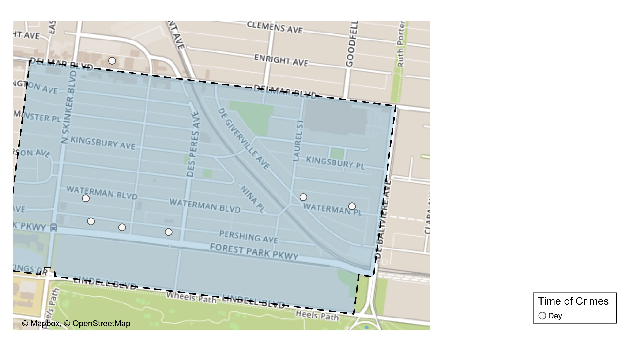
Skinker DeBaliviere: Time of Crimes Map

Slide 22
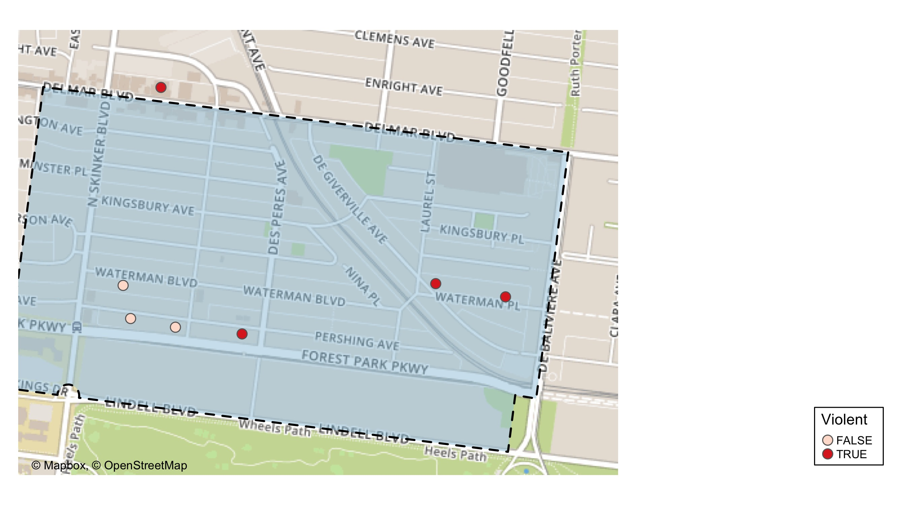
Skinker DeBaliviere: Violent Crime Map

Slide 23
Skinker DeBaliviere: Larceny Breakdown
Day of the Week | Number of Crimes
Thu | 1
Sat | 1
Total | 2
Type of Larceny | Number of Crimes
From Building | 1
From Motor Vehicle | 1
Total | 2
Time of Day | Number of Crimes
Day | 2
Total | 2
Monetary | Number of Crimes
$500 - $24,999 | 1
Under $500 | 1
Total | 2

Slide 24
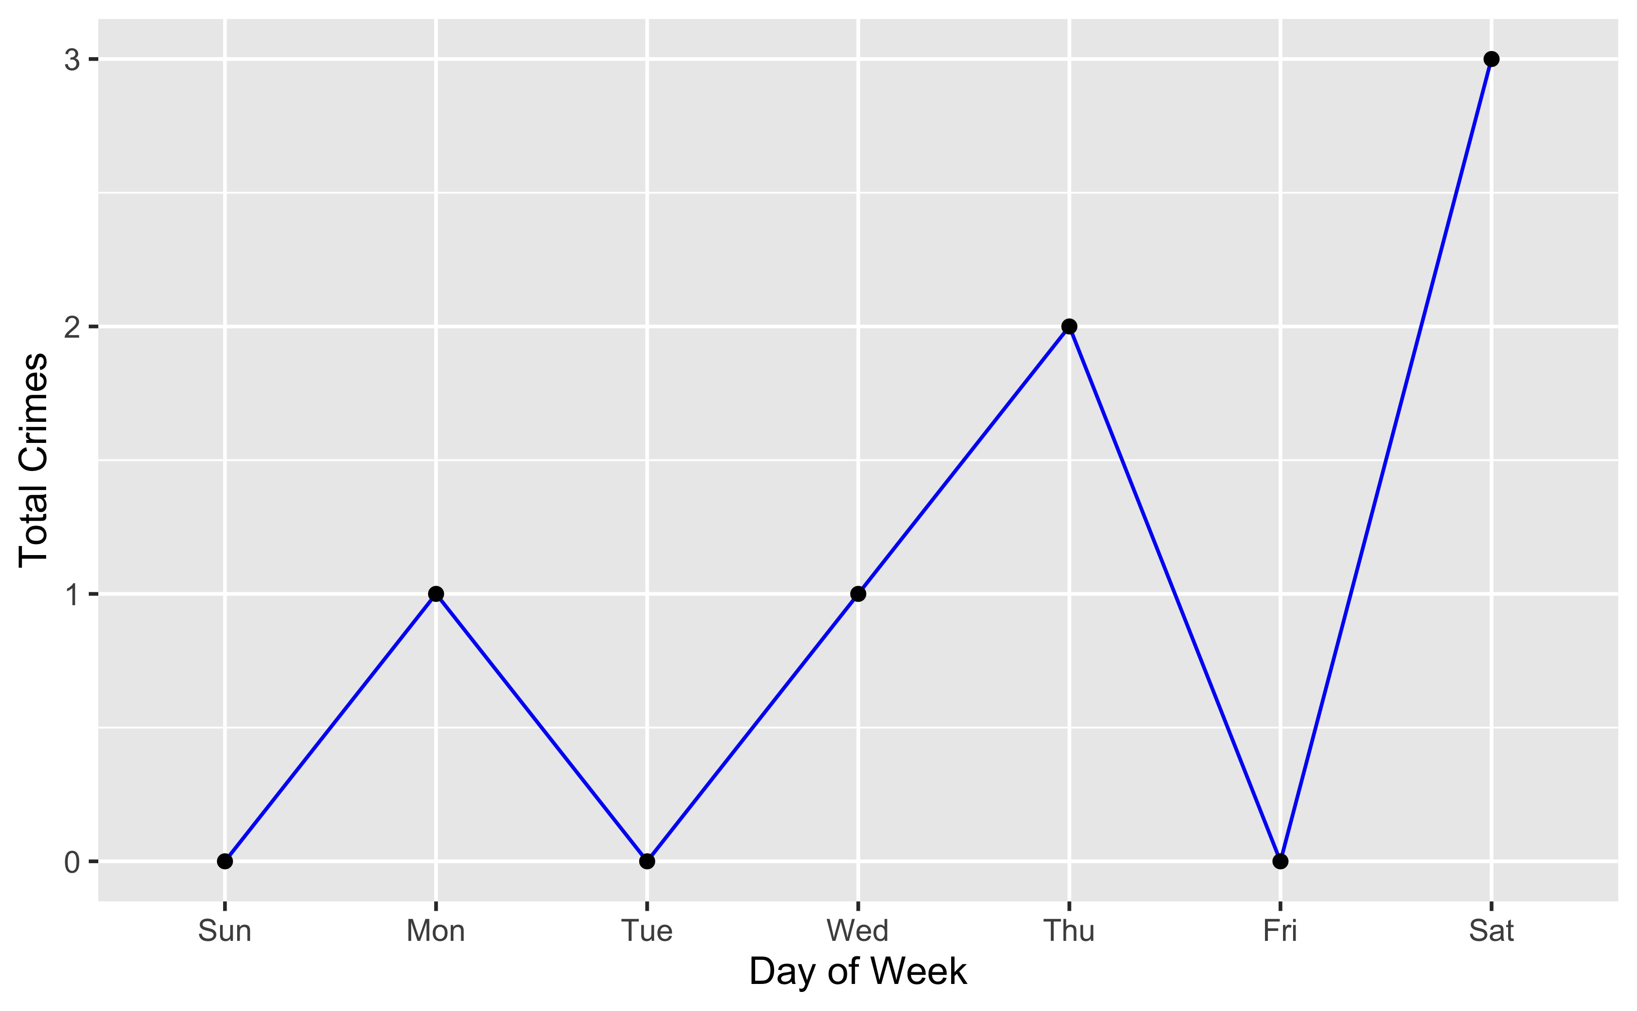
Skinker DeBaliviere: Total Crimes by Days of the Week

Slide 25
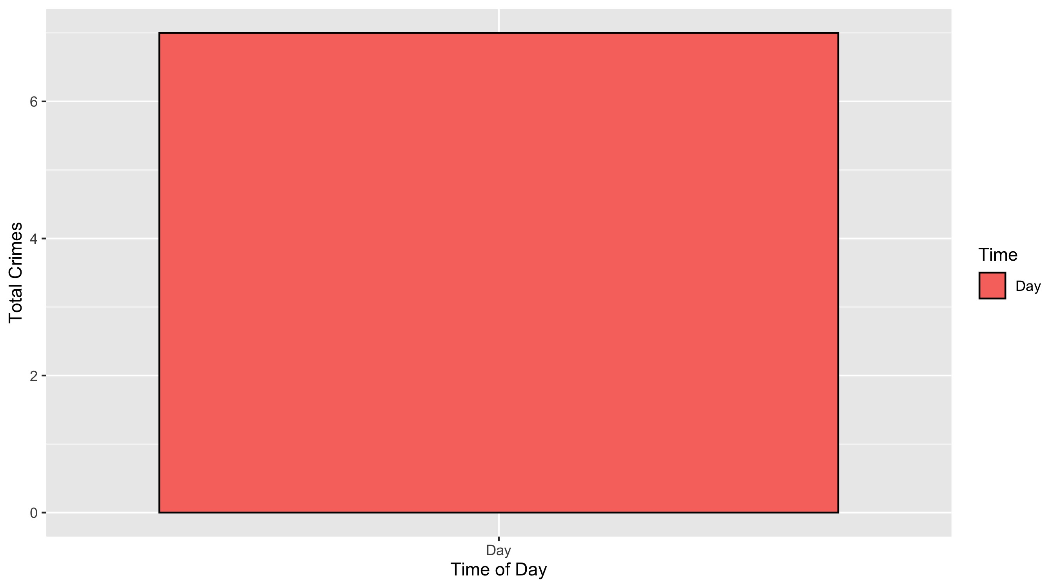
Skinker DeBaliviere: Crimes by Time of Day

Slide 26
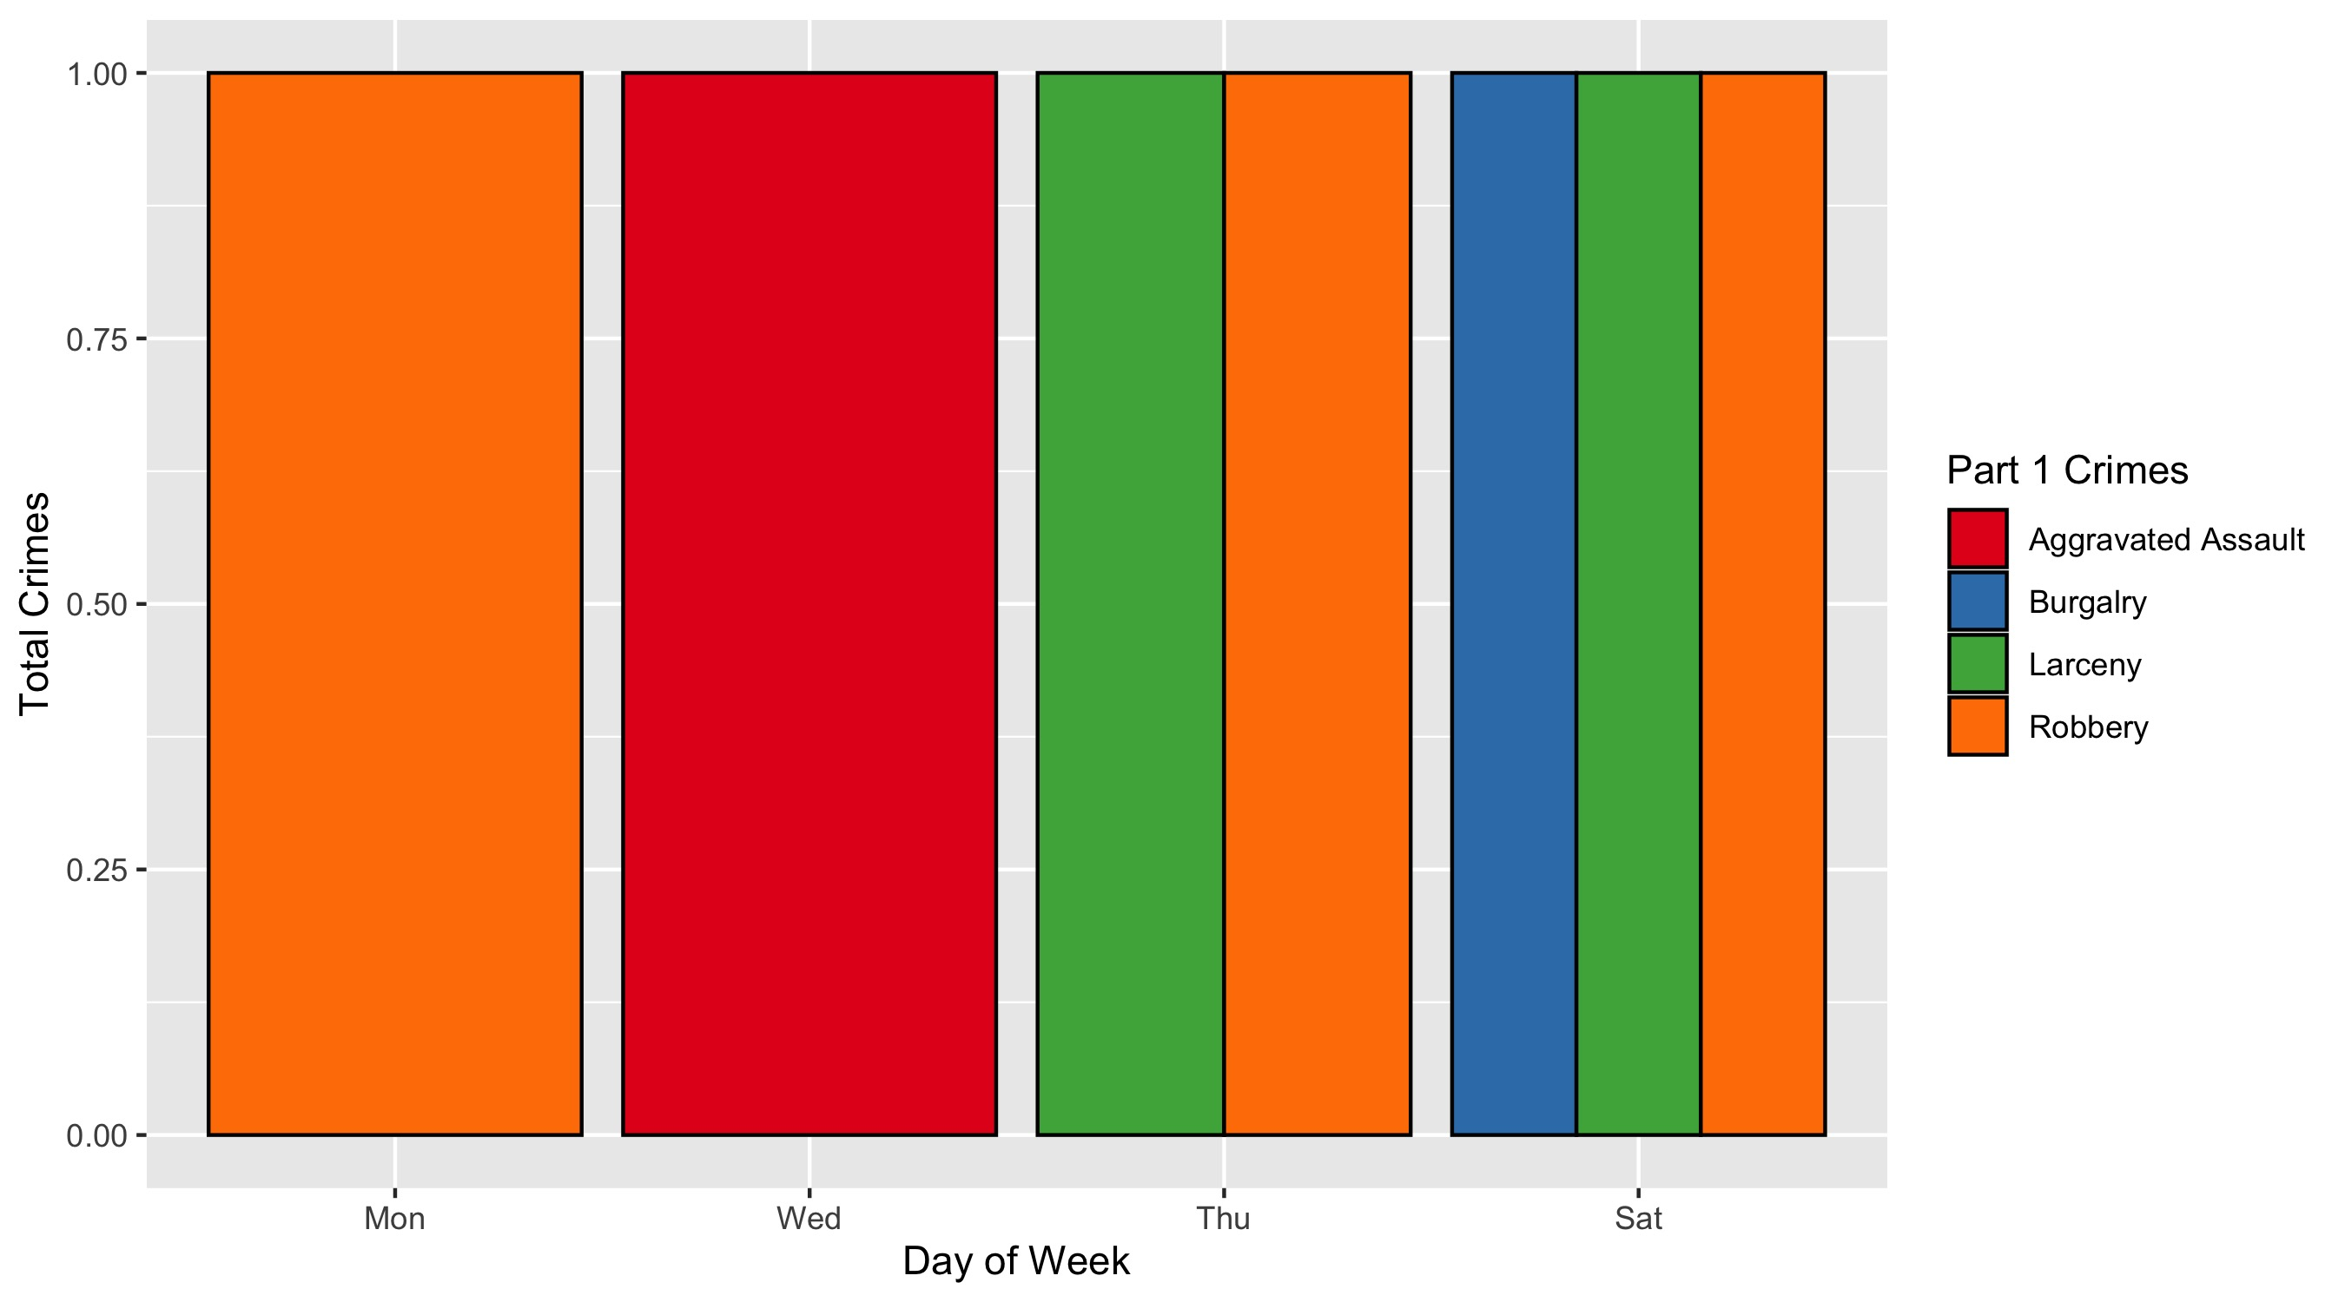
Skinker DeBaliviere: Crimes by Day & Category

Slide 27
DeBaliviere Place: Neighborhood Detail
Appendix 2

Slide 28
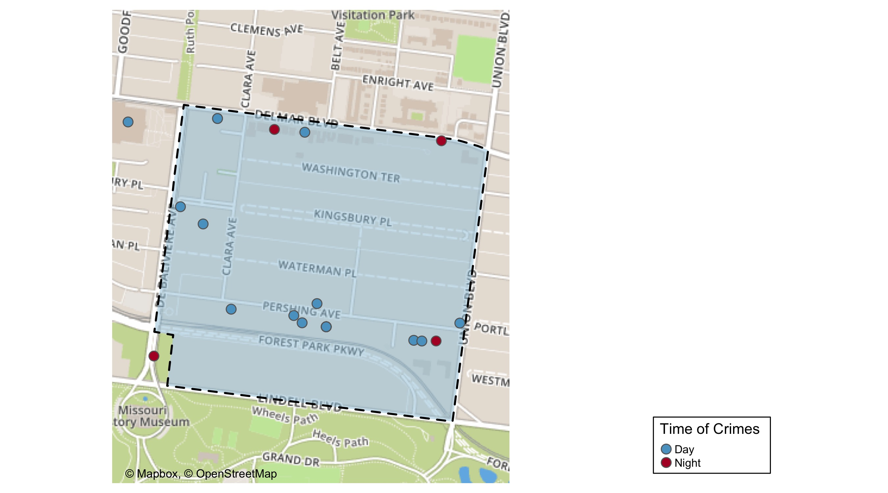
DeBaliviere Place: Time of Crimes map

Slide 29
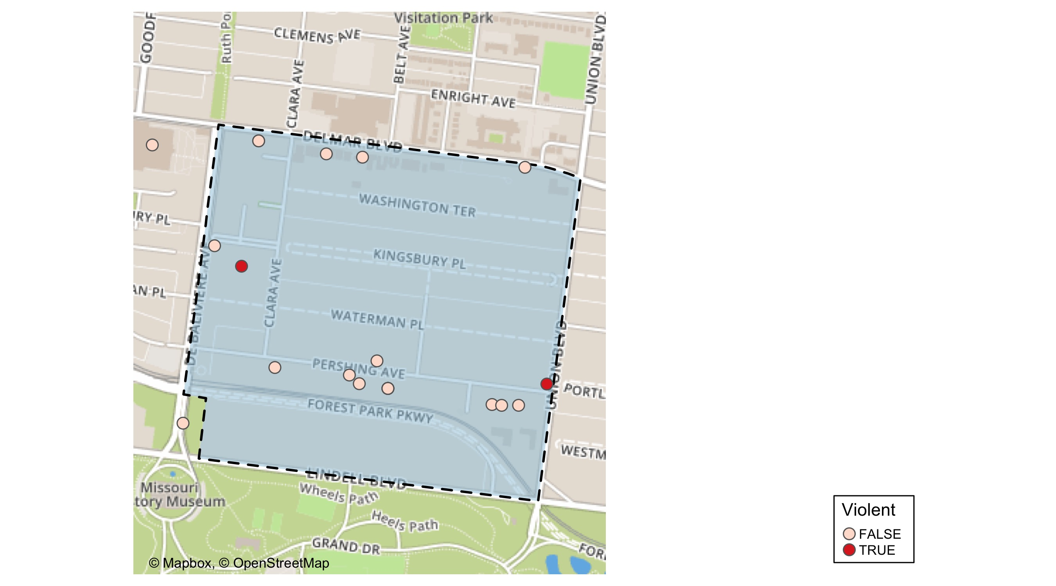
DeBaliviere Place: Violent Crime Map

Slide 30
DeBaliviere Place: Larceny Breakdown
Day of the Week | Number of Crimes
Sun | 2
Mon | 2
Tue | 1
Wed | 1
Thu | 6
Fri | 6
Sat | 2
Total | 20
Type of Larceny | Number of Crimes
From Building | 11
From Motor Vehicle | 7
Motor Vehicle Parts | 2
Total | 20
Time of Day | Number of Crimes
Day | 18
Night | 2
Total | 20
Monetary | Number of Crimes
$500 - $24,999 | 5
Under $500 | 15
Total | 20

Slide 31
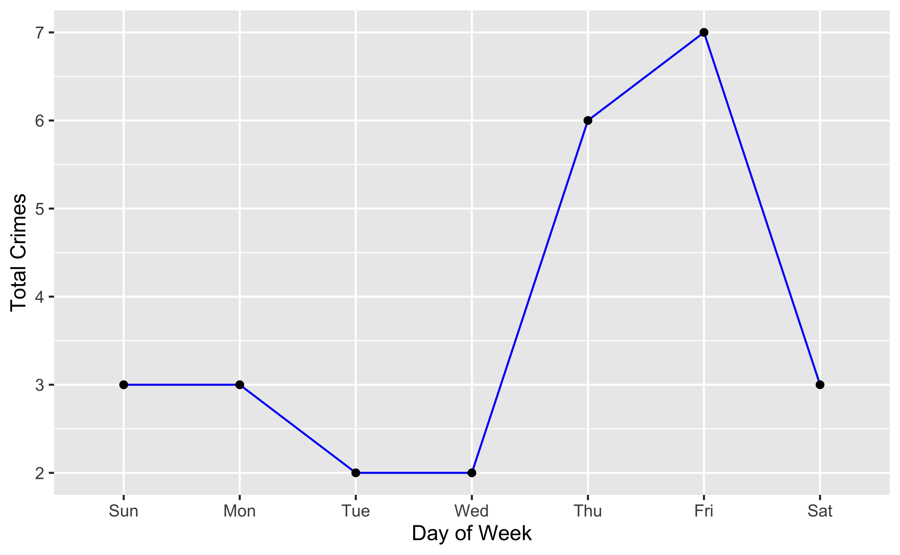
DeBaliviere Place: Total Crimes by Days of the Week

Slide 32
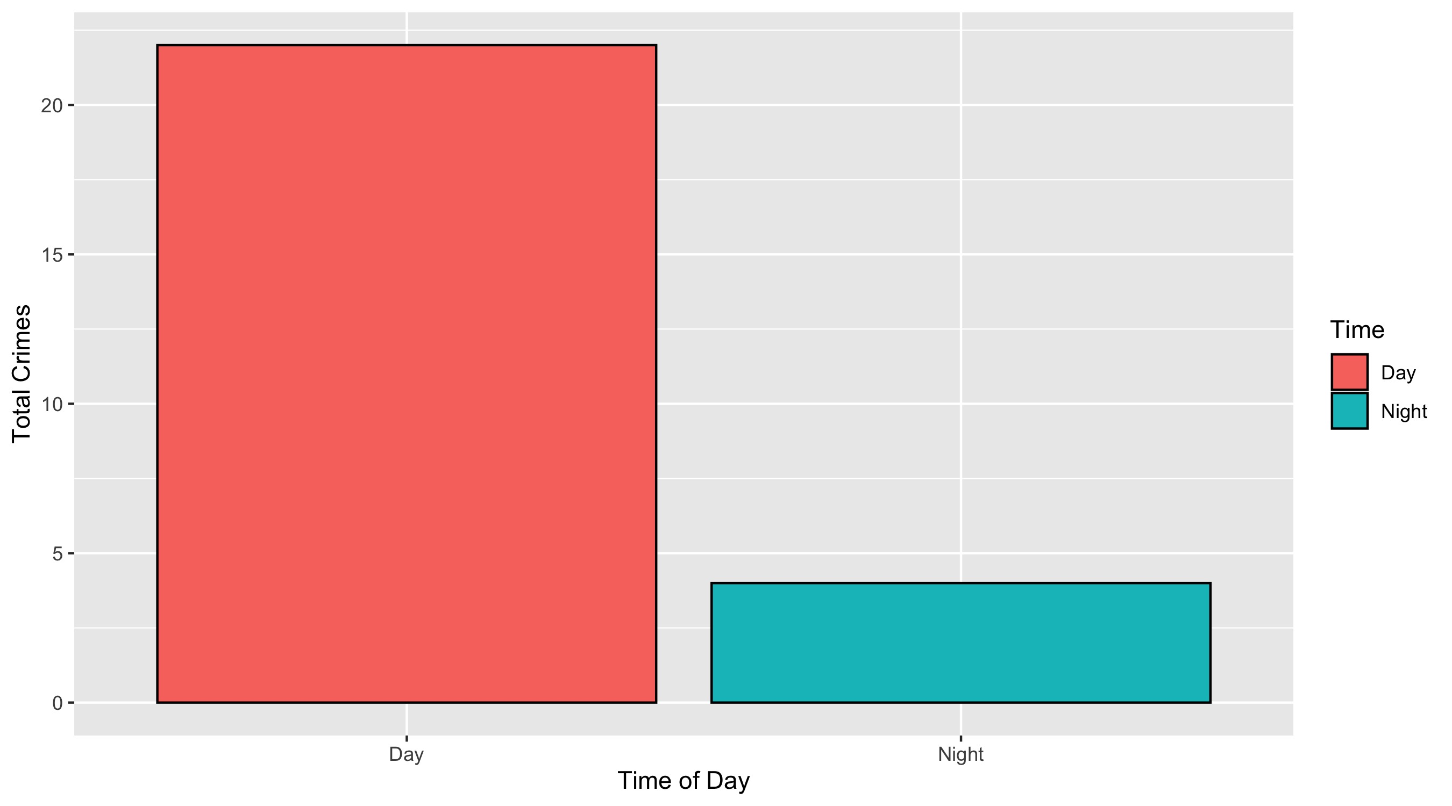
DeBaliviere Place: Crimes by Time of Day

Slide 33
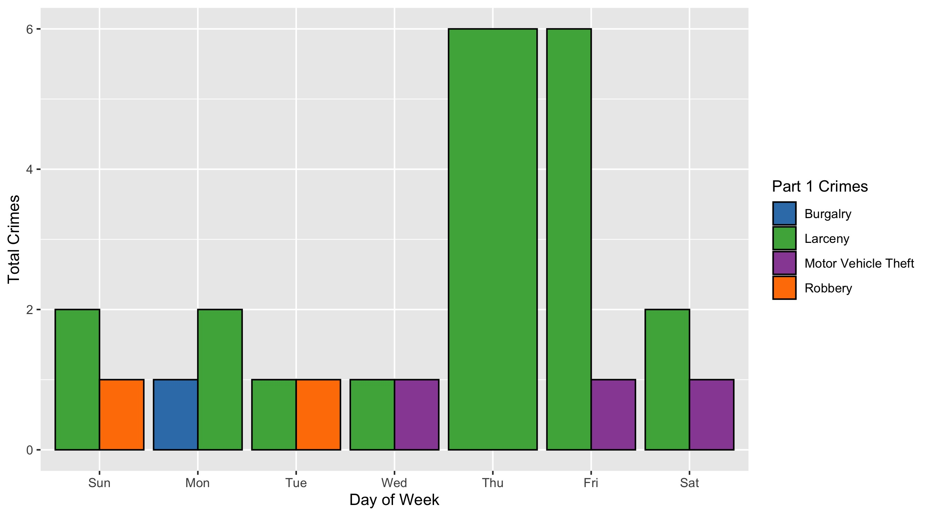
DeBaliviere Place: Crimes by Day & Category

Slide 34
West End: Neighborhood Detail
Appendix 3

Slide 35
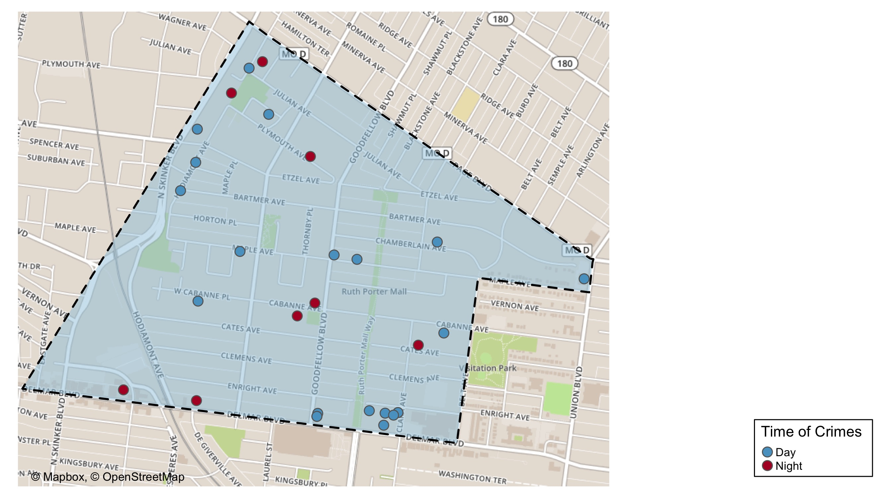
West End: Time of Crimes Map

Slide 36
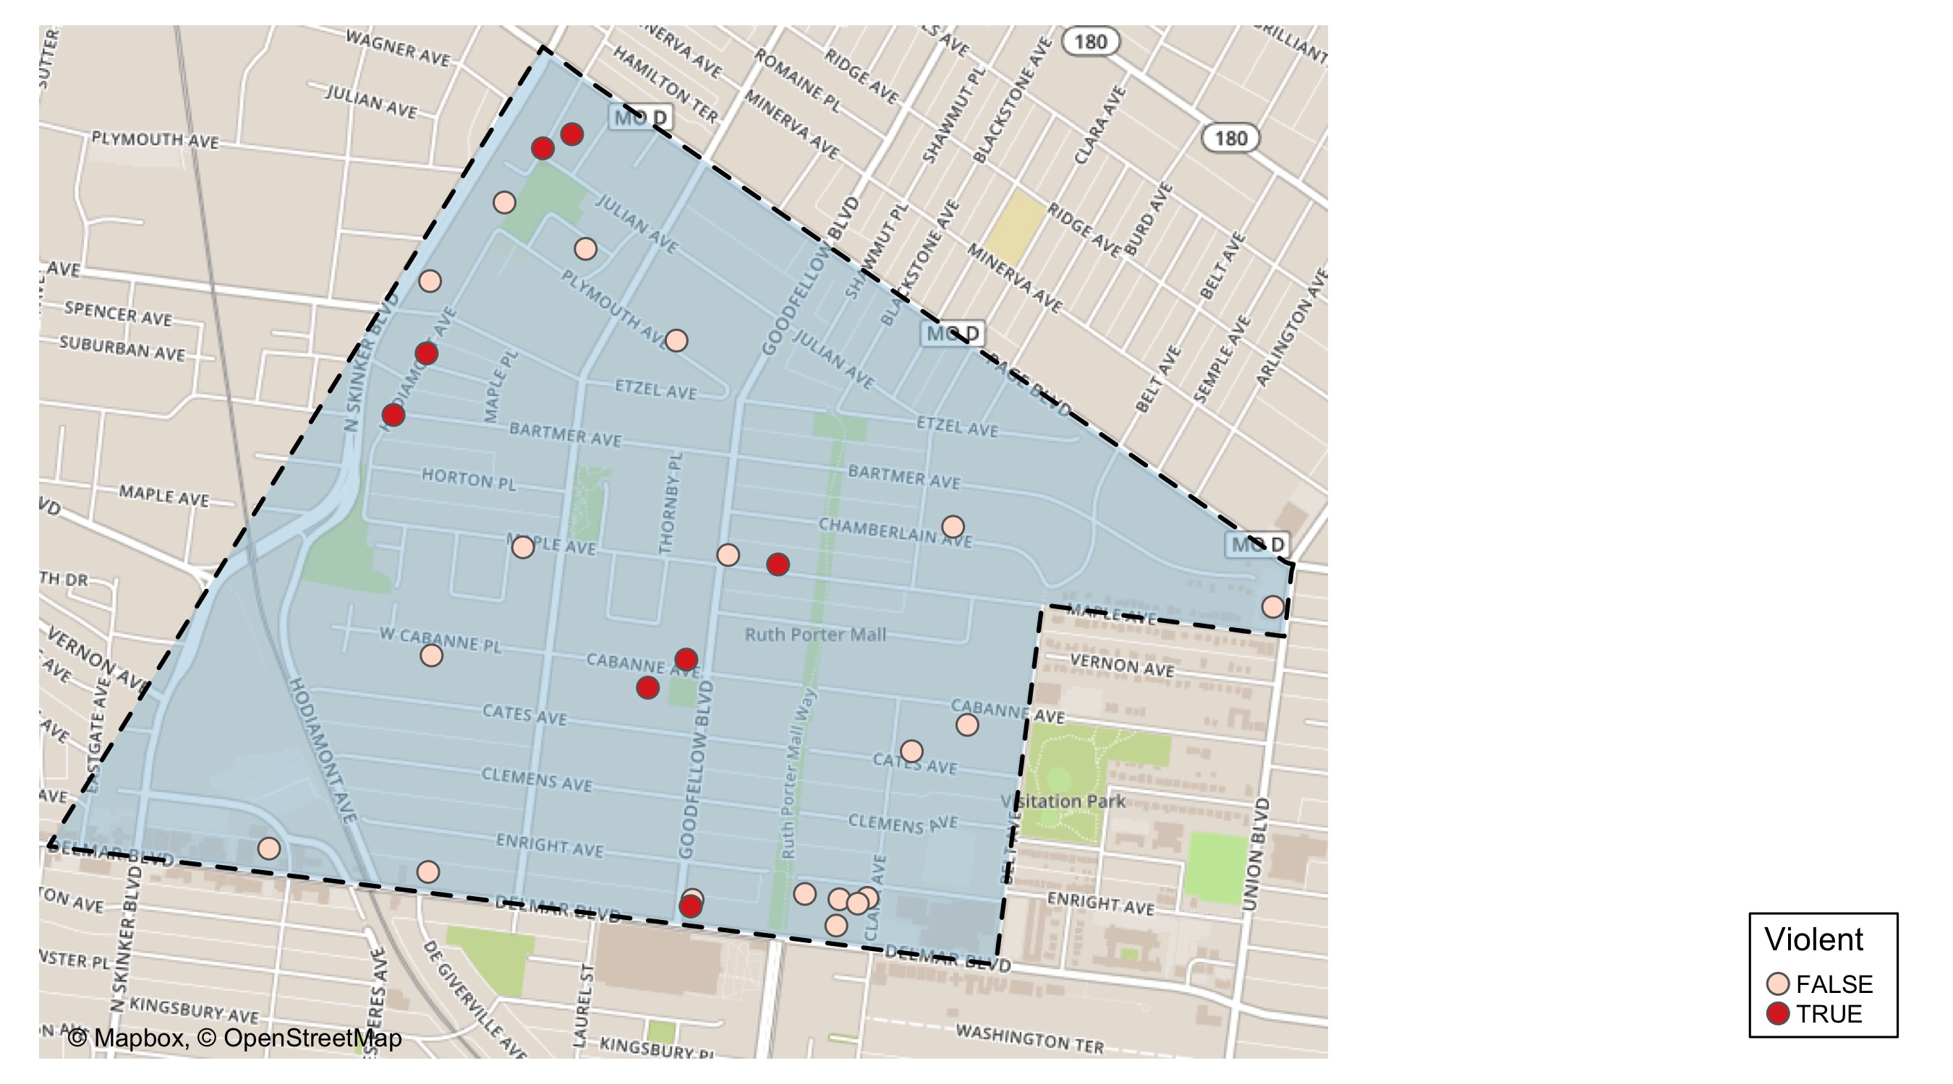
West End: Violent Crime Map

Slide 37
West End: Larceny Breakdown
Day of the Week | Number of Crimes
Sun | 3
Tue | 4
Wed | 1
Thu | 2
Sat | 6
Total | 16
Type of Larceny | Number of Crimes
All Other | 2
From Building | 2
From Motor Vehicle | 7
Motor Vehicle Parts | 4
Shoplifting | 1
Total | 16
Time of Day | Number of Crimes
Day | 14
Night | 2
Total | 16
Monetary | Number of Crimes
$500 - $24,999 | 4
Under $500 | 12
Total | 16

Slide 38
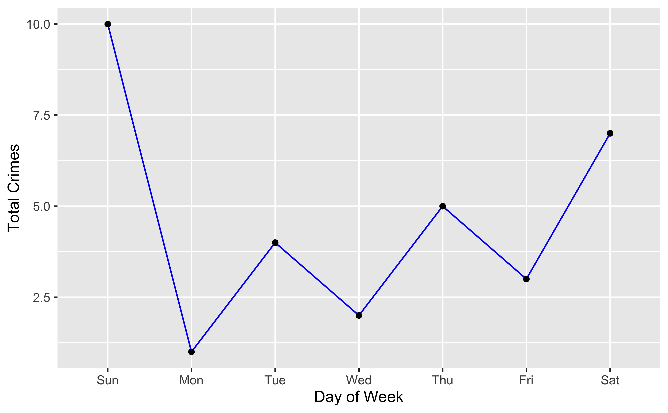
West End: Total Crimes by Days of the Week

Slide 39
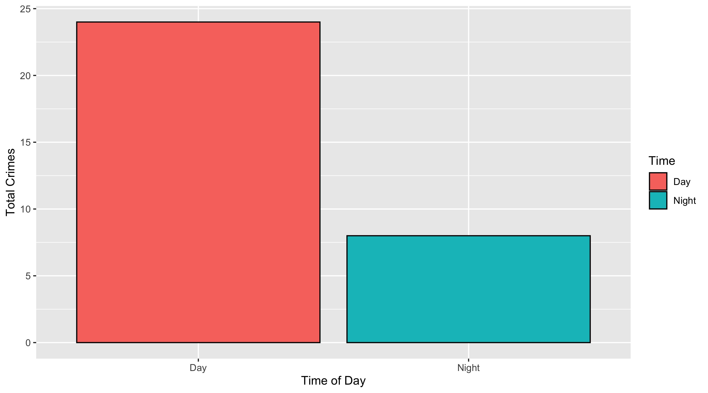
West End: Total Crimes by Days of the Week

Slide 40
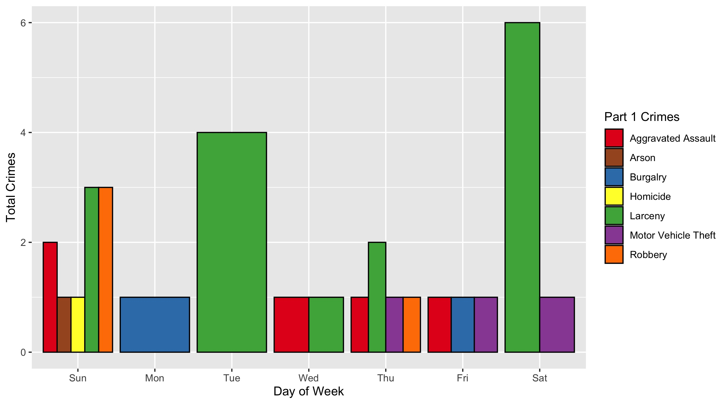
West End: Crimes by Day & Category

Slide 41
Visitation Park: Neighborhood Detail
Appendix 4

Slide 42
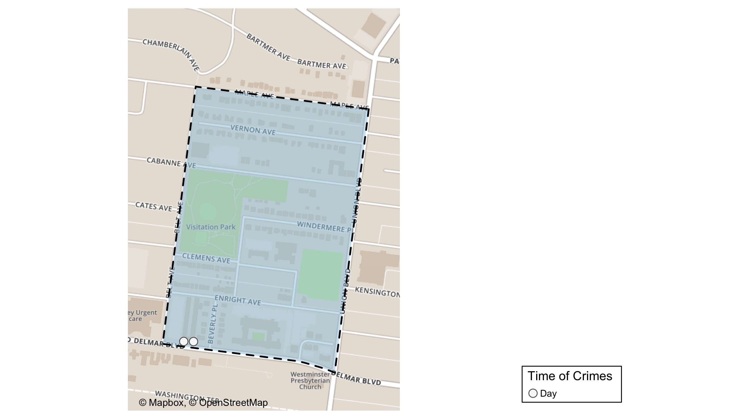
Visitation Park: Time of Crimes Map

Slide 43
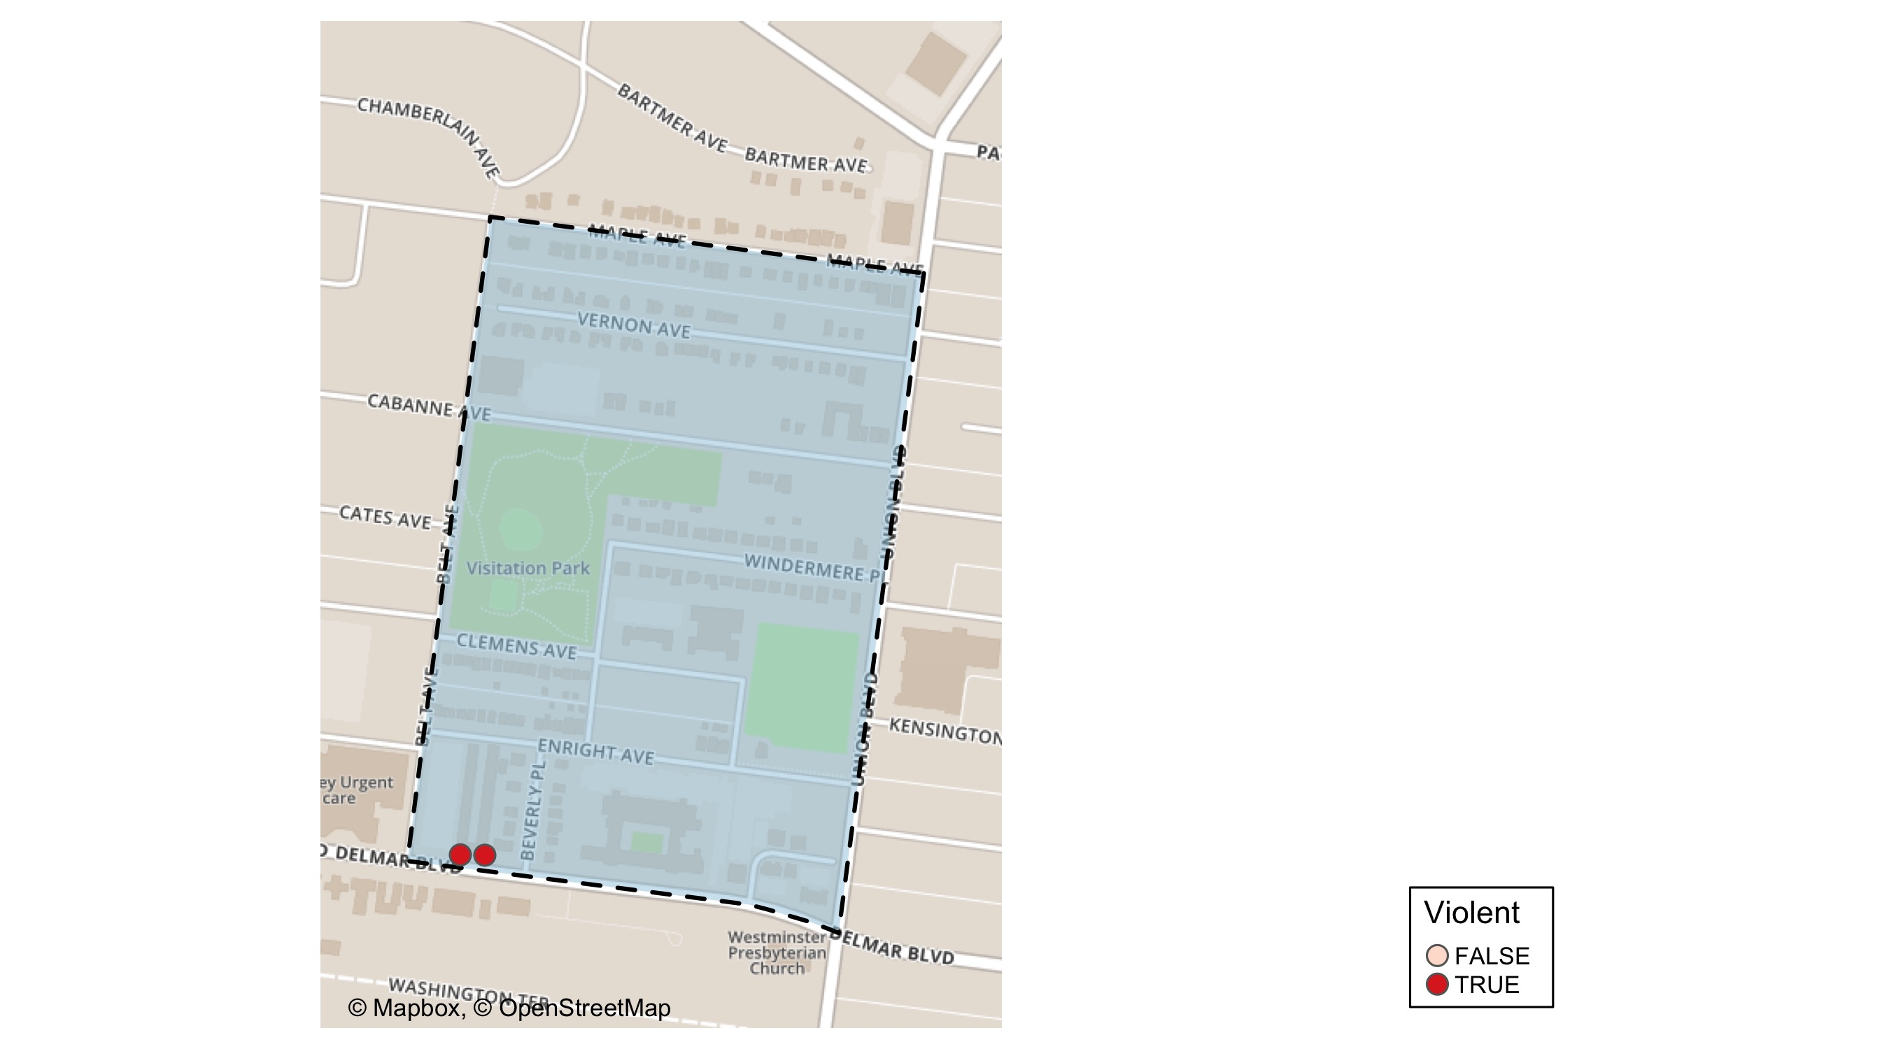
Visitation Park: Time of Crimes Map

Slide 44
Visitation Park: Larceny Breakdown
Day of the Week | Number of Crimes
Total | 0
Type of Larceny | Number of Crimes
Total | 0
Time of Day | Number of Crimes
Total | 0
Monetary | Number of Crimes
Total | 0

Slide 45
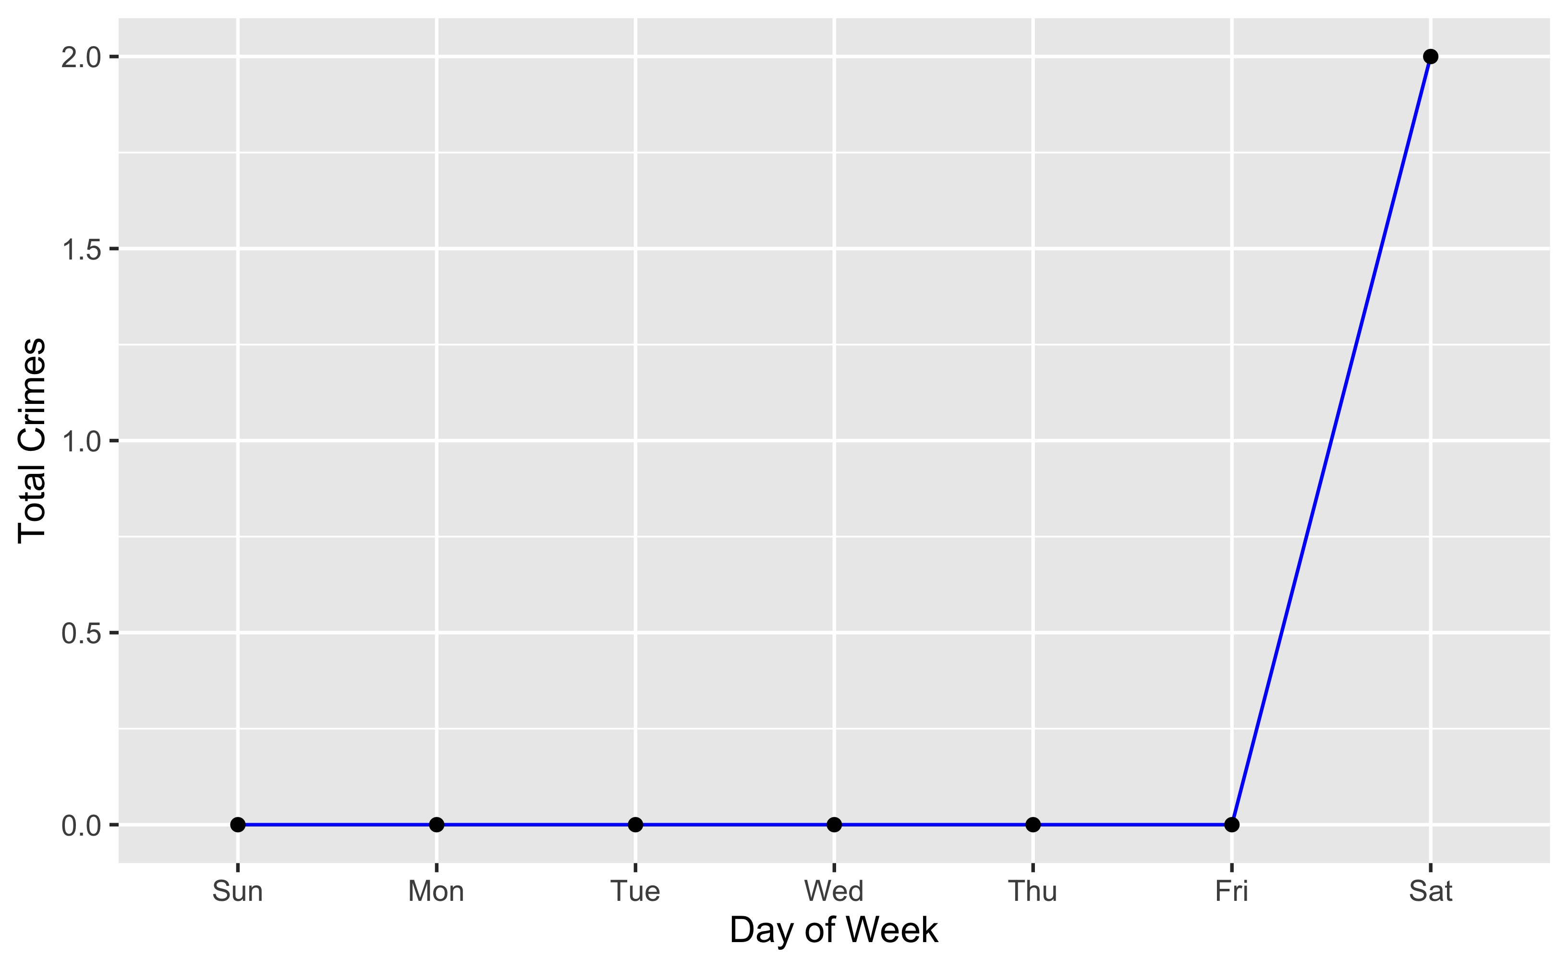
Visitation Park: Total Crimes by Days of the Week

Slide 46
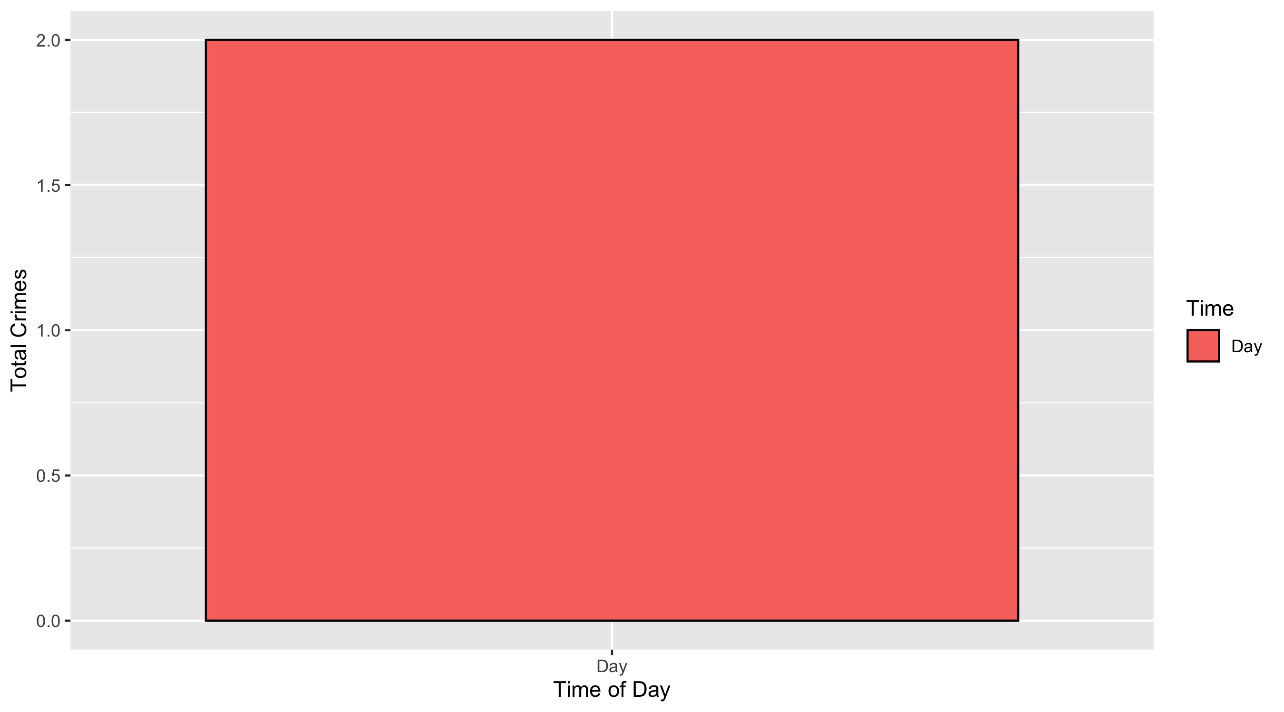
Visitation Park: Crimes by Time of Day

Slide 47
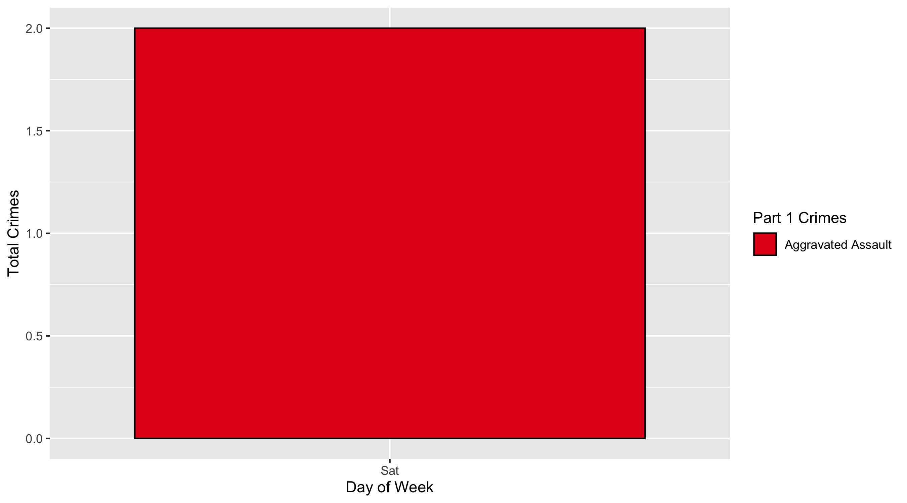
Visitation Park: Crimes by Day & Category

